Slide 1




EW1: Final Evaluation
Smart Thermal Cooling System
Gauri Krishnan, Sudeepti Polnati
Team ID: 28
TA: Ananya Varma

Slide 2

Motivation
When certain machines are in use for a long period of time, excessive heating occurs and this negatively affects the efficiency of the system.
In certain cases, the system might even shut down, thereby causing huge production loses.
The motivation of our project is to find a solution for this.

Slide 3
Problem Statement
We would like to design a system that maintains the temperature within an ideal range.
Once the temperature crosses a certain threshold, the cooling mechanism will start working.
We will also make the system fully automated, so that overheating will be monitored and the machine can automatically be cooled down.

Slide 4
Proposed Design
In this project, we will use an aluminium plate that is heated up to mimic the heat build up in the machine, sense this heat build-up, and then cool it down, and then cool it down when it crosses the high threshold.
Conversely, when the temperature is below the lower threshold value, the cooling system should switch off.
To achieve this, we need to use a temperature sensor to detect when the heat is beyond a threshold value so that we can turn the cooling system on.
The sensor that we are using is a Adafruit TMP117 High Accuracy I2C Temperature Sensor.

Slide 5
For our cooling system, we are using a fan and a water pump.
The system is automated using the temperature sensor and Arduino.
To switch on the fans and water pump only when needed, we used relay modules.
The temperature sensor will consistently be reading the temperature of the plate.
When the plate reaches 42 degrees Celsius, the Arduino will switch on the fan and water pump by using the relay.
The wind from the fan is directed towards the plate and the water from the pump is sprayed onto it.
When the plate is cooled down enough, and the temperature sensor reaches 38 degrees, the pump is switched off, and when it reached 35, the fan switches off.

Slide 6


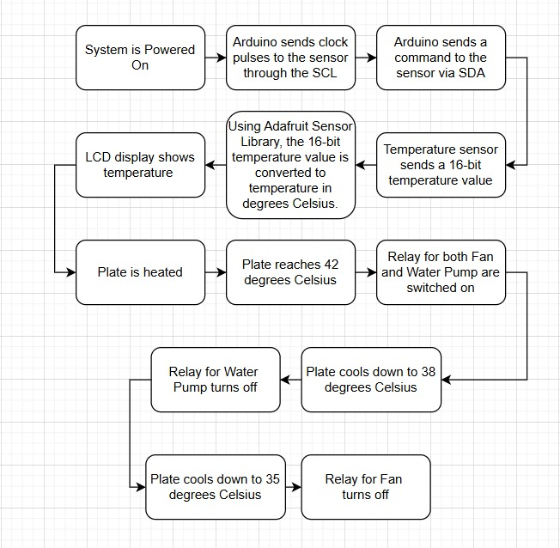
Block diagram

Slide 7
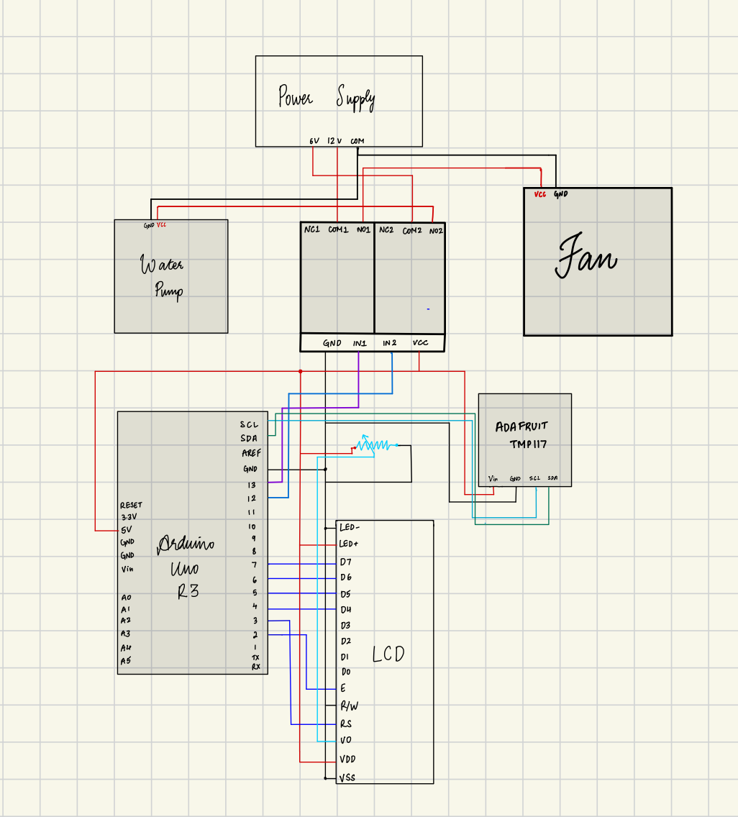
Circuit diagram

Slide 8
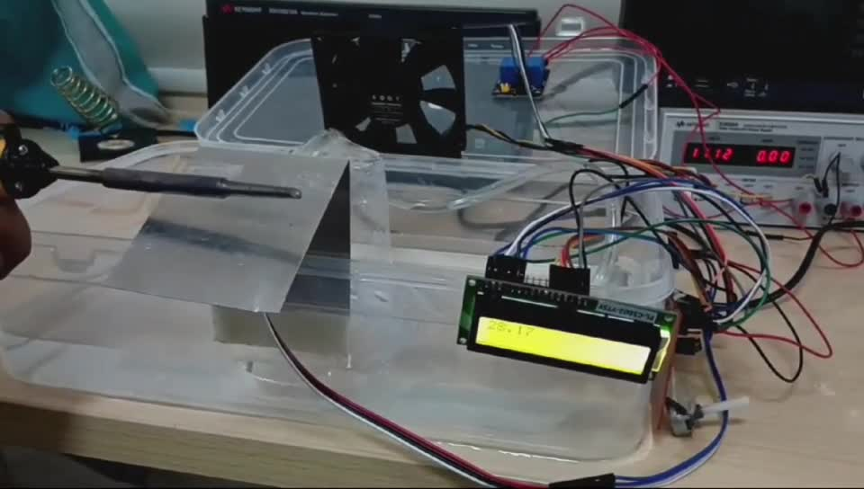
Demo

Slide 9
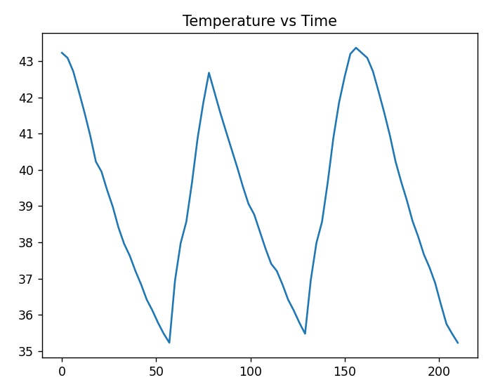
Key Performance Indicator
This graph shows the relation between temperature and time in the cooling system.
The cooling is effective, and the temperature drops quickly in a short amount of time.

Slide 10
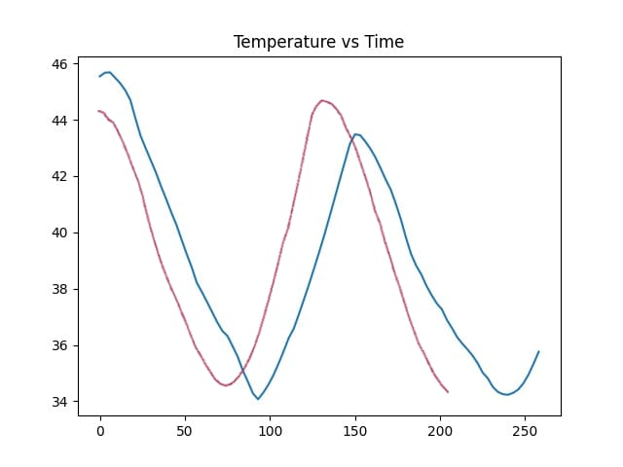
The red curve represents the run-time characteristics if only the fan is used, whereas the blue curve represents the cooling when only the water pump is used.
As can be observed from the graph, the fan is more effective in cooling in our hardware setup.

Slide 11
Practical Implementations:
This system is very practical, even being implemented in a multitude of scenarios:
The system of using fans and water pumps to cool down components is implemented even in automobiles, machinery, and even for maintaining servers in Data Centres.
The project is cost efficient as it prevents the major production losses that would have occurred due to overheating of the machines.

Slide 12


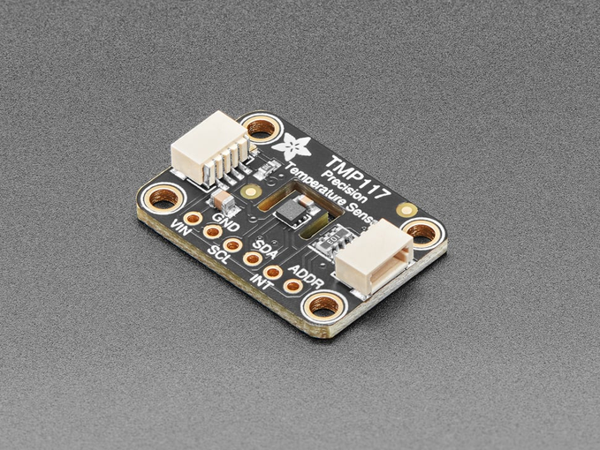
Cost of the Solution
Adafruit TMP117 High Accuracy I2C Temperature Sensor
1000
3-6V DC Water Pump
60
12V DC Fan
300
5V 2-Relay Module
50
Arduino UNO
200
Arduino Cable
20
Plastic Box
150
Total Cost: 1780

Slide 13


Learnings from the Project
Different types of Temperature Sensors and how to use them.
How I2C as well as SCL and SDA work
About Relays and their functioning
Working of the LCD

Slide 14
Remarks
We had issues with the LCD due to lose connections and improper soldering, which caused the screen to output garbage values.
We included PWM to change the speed of the fan according to the temperature.
However, since Arduino was supplying power for both PWM and LCD, signal integrity issues arised.

Slide 15
References
Temperature Sensor: https://learn.adafruit.com/adafruit-tmp117-high-accuracy-i2c-temperature-monitor/arduino
Fan: https://www.youtube.com/watch?v=fimVrT7NFFU
Water Pump: https://www.youtube.com/watch?v=xNIedHi9PL8
LCD Display: https://docs.arduino.cc/learn/electronics/lcd-displays/

